Slide 1
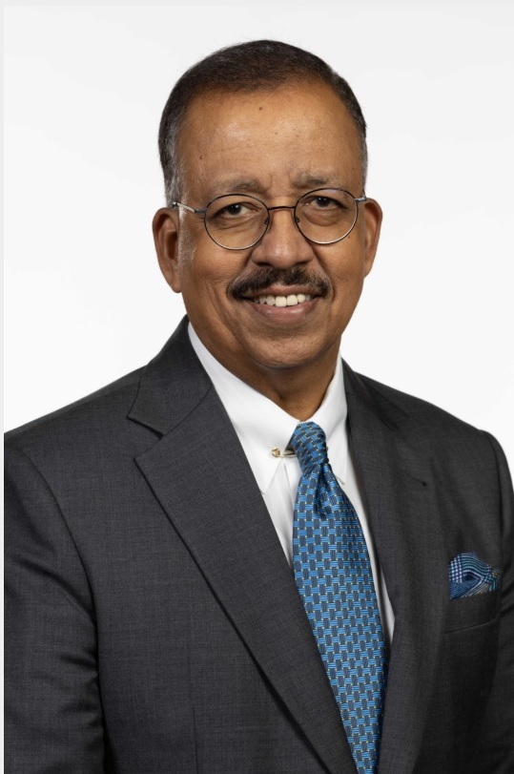
Dr. Srini Srinivasan Managing Director, PMI South Asia
Profile Summary:
Srini has over 30 years of global professional experience as a CEO, senior management consultant and entrepreneur in India, Asia and the US
India CEO and senior US Partner of three global management consultancies, where he was a trusted adviser to CXOs across multiple industry sectors
Interim CEO of an engineering services company
Had a hand in five successful start-ups in areas as diverse as biomedical technology, consulting services, outsourcing and knowledge management
Has managed complex multi-geography, multi-BU enterprise transformation projects
Education:
Ed.D., University of Northern Colorado
MBA, Eastern New Mexico University
B. Com., University of Madras

